Slide 1
Inferring Sleep Deprivation Risk Patterns from NHANES Data
Identifying Key Drivers of Sleep Deprivation
STT 811: Applied Statistical Modeling
Dae Young Kim
Jihoon Choi
Victor Pietono
Notes:
Discussion Post:
will generate a 1–2 page summary document based on our presentation slides using Overleaf.
will share the Overleaf link by Sunday.
Code Submission:
No need to translate or combine the code files.
ill submit the two main code files separately, along with a README file explaining the purpose of each code (e.g., EDA, XGBoost modeling, etc.).

Slide 2
Outline
Contents
Introduction
Dataset Overview
Data Cleaning and Preprocessing
Feature Selection
Exploratory Data Analysis (EDA)
Feature Engineering
Model Construction
Model Evaluation
Conclusion

Slide 3
Introduction
Problem
Sleep deprivation is a widespread but underdiagnosed health issue.
Symptoms like fatigue often mimic other conditions (e.g., depression, hypertension), making detection difficult.
While traditional identification relies on self-reported sleep questionnaires, incorporating health, demographic, and lifestyle factors can more robustly flag sleep deprivation risk.
Project Goal
Develop a predictive model to flag individuals at risk of sleep deprivation using existing clinical and survey data
Identify key determinants of sleep deprivation, focusing on demographic factors, health behaviors, and biological markers.
Support healthcare providers with a low-cost, scalable screening tool for routine visits.
Raise public and clinical awareness about sleep health using U.S. population-level data (NHANES).

Slide 4
Dataset Overview
NHANES (National Health and Nutrition Examination Survey)
Description
A nationally representative health survey by the CDC
Combines interviews, physical exams, lab tests, and questionnaires
Used 2017-2020 and 2021-2023 cycles, using a combined sample of ~18,000 individuals
Key Features
Lab Data: Inflammation, Metabolism, Lipids, Hormones, Nutrition
Demographics: Age, Gender, Race/Ethnicity, Education
Measurement: Weight, Height, BMI, Waist Size, Blood Pressure
Questionnaires: Sleep habits, Smoking, Alcohol, Income, Weight History

Slide 5
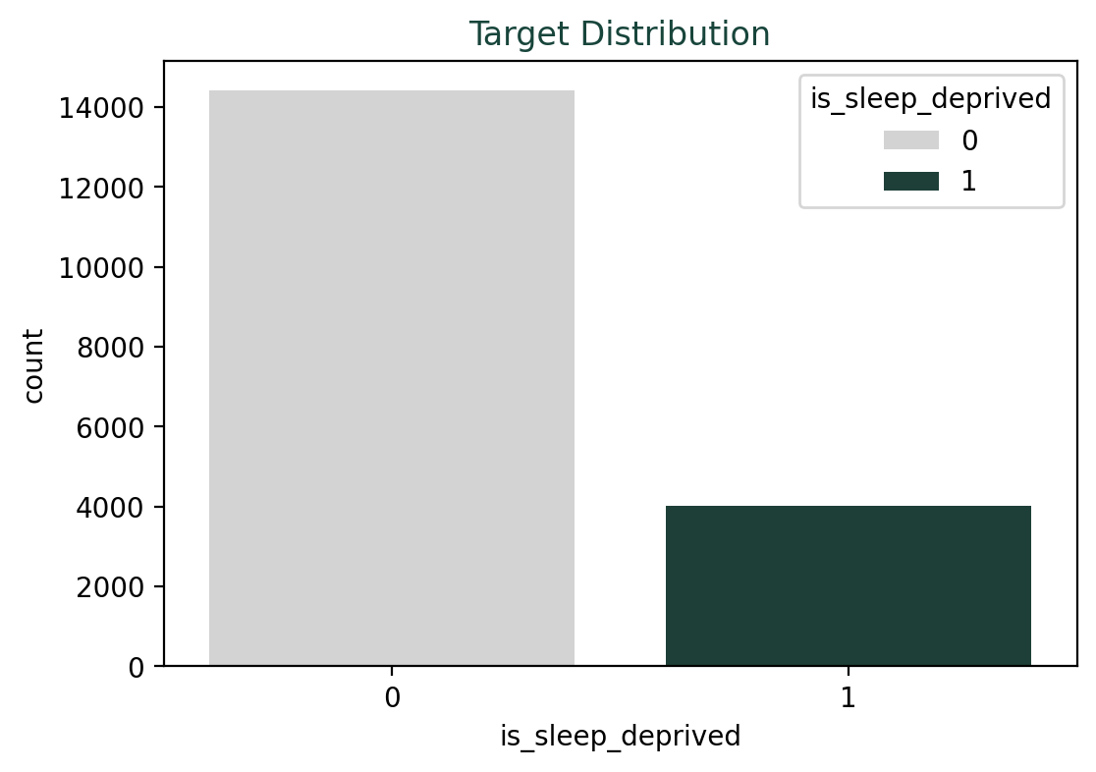
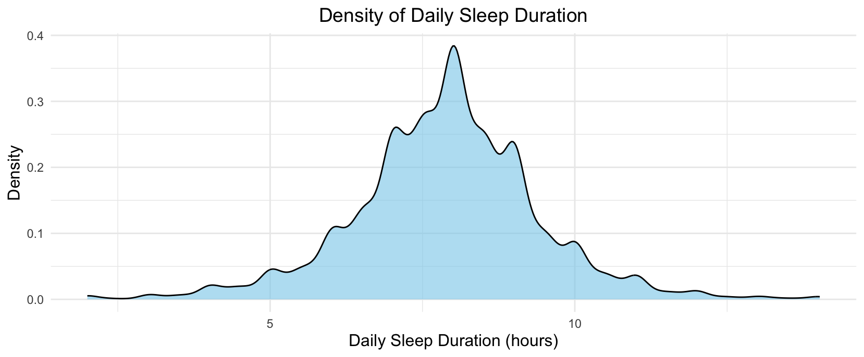
Dataset Overview
Target Variable
Sleep Deprivation
Calculated from weekday/weekend sleep start and end times
Individuals averaging < 7 hours of sleep/day are labeled as sleep deprived.
Note: weekday/weekend sleep end time is not included as predictor to avoid information leakage

Slide 6
Data Cleaning & Preprocessing
Data Cleaning
Recoded “Refused”, “Don’t know”, and blanks as missing
Dropped variables with 1) > 20% missingness, 2) low or no variance, and 3) missing target variable
Feature Selection: Dual Selection
Filter method: Top 30 numeric (ANOVA F-test) + Top 10 categorical (χ²)
Wrapper method: RFE (w/ XGBoost) → Select top 40 predictive features
Combine & Prune: Union → further feature selection based on feature importance (XGBoost)
Missing-Value Imputation
Split into numeric and categorical, imputed missing values with IterativeImputer with XGBRegressor (for numerics) and XGBClassifier (for categoricals)
Notes:
it’s real-world data, including survey questionnaires, so many records had wrong values or missing values … (very dirty)
for the presenter, you can also mention a bit that unlike modern ML methods like trees or neural nets, GLM needs some feature engineering to break the non-linearity and boost the performance.
cheatsheet: weekday_sleep_timing (binary: low_risk vs high_risk, 18:00-23:00 vs 24:00-17:00)

Slide 7
Data Cleaning & Preprocessing
Multicollinearity
Multicollinearity can causes GLM model to have:
Parameter instability
Inflated standard errors
Interpretation problems
Modern ML techniques such as ensemble trees are more robust against collinearity compared to GLM when prediction is primary goal with the interpretation at the cost.
We are using VIF testing (Variance Inflation Factor) with threshold of 5 to handle the multicollinearity.
It is important to drop variables one-by-one since the correlation structure changes after each removal. VIF values must be recalculated for remaining variables as their interdependencies shift.
Notes:
Cheat sheet for questions:
Parameter instability
Parameter instability occurs in multicollinearity because small changes in the data can lead to large, unpredictable shifts in coefficient estimates. Since correlated predictors contain overlapping information, the model struggles to allocate effects between them, making coefficient values highly sensitive to minor data variations and potentially changing sign or magnitude dramatically with small dataset changes.
Inflated standard errors
Multicollinearity inflates standard errors because the model cannot precisely estimate which of the correlated variables is causing the effect on the dependent variable, increasing uncertainty in coefficient estimates. This uncertainty is reflected in larger standard errors.
Interpretation problems
Multicollinearity makes it impossible to isolate the independent effect of each predictor. When variables are highly correlated, you cannot interpret a coefficient as representing the effect of changing one variable while holding others constant, since changing one correlated variable inherently changes others.

Slide 8
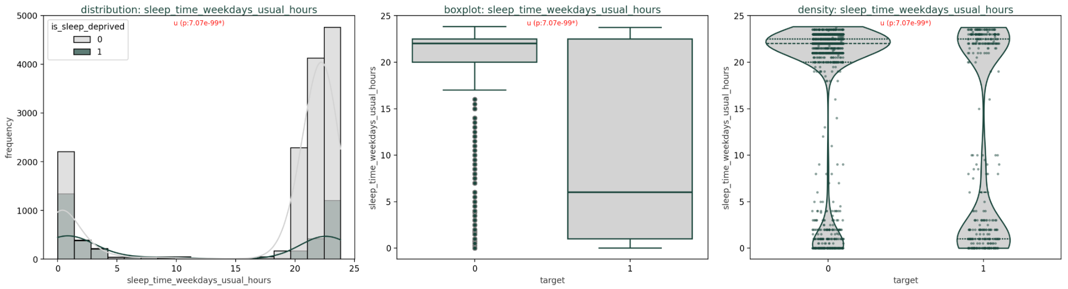
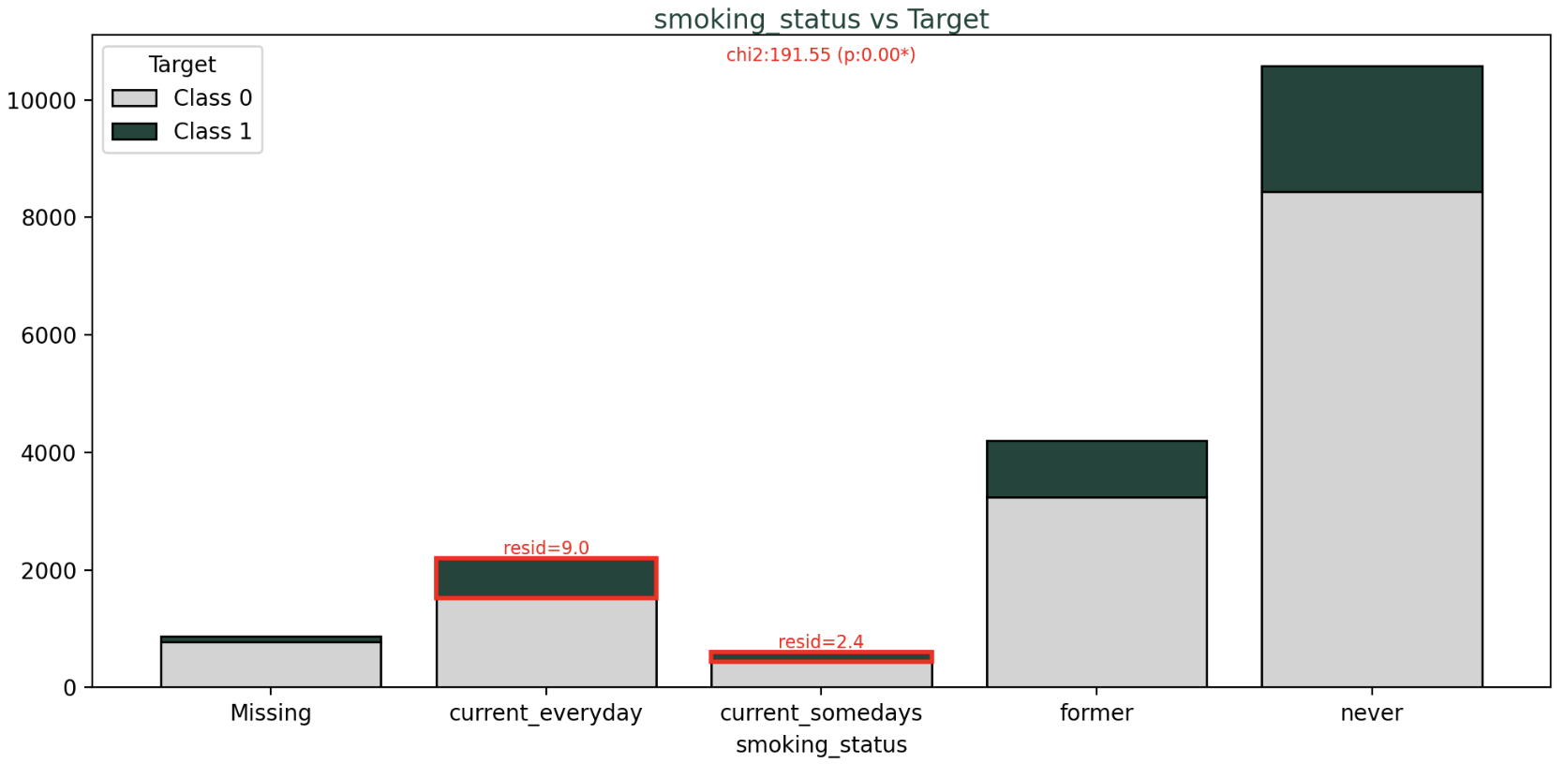
EDA on Selected Features
Numerical
Distribution, median, outlier, density (Violin+Stripplot) by class
Difference between Class 1 and 0
Normality check → Shapiro-Wilk test
1) Normal → T-test (mean),
2) Non-normal → Mann-Whitney U test (median)
Correlation, VIF (multicollinearity)
Categorical
Overall variable significance
→ Chi-squared test
Category-level significance
→ Standardized residuals of Chi2
“Which specific categories drive that significance, particularly for Class 1?”
Notes:
Next, we did EDA for the selected features.
// 1) For numerical features, we checked their distribution, median, outliers, and density using violin and strip plots. To compare Class 1 and 0, we first ran a normality test with Shapiro-Wilk. If the data was normal, we used a T-test to compare their means. If non-normal, we used the Mann-Whitney U test to compare their distribution based on medians. We also checked correlations and VIF for multicollinearity.
// → Here, we found that bedtime, age, and smoking status are important for sleep deprivation (Class 1).
// 2) For categorical features, we used the Chi-squared test to check overall significance. To find which categories matter most, we also looked at standardized residuals from the test. This showed which categories drive that significance, especially for Class 1.
// → For instance, current smokers, weight change status, and high sedentary level came out to be key for sleep deprivation (Class 1).
// And we also utilized these important features to build our naive model.
—--------------------
Shapiro-Wilk Test: Tests if data follows a normal distribution (bell-shaped curve). If p-value is low, data is non-normal.
T-test: Compares means of two groups (Class 1 vs. Class 0) for normal data. Low p-value means means are different.
Mann-Whitney U Test: Compares medians of two groups for non-normal data. Low p-value means medians differ.
VIF (Variance Inflation Factor): Checks if features are too correlated (multicollinearity). High VIF (>5) means features may cause issues.
Chi-squared Test: Tests if a categorical feature is related to the target (Class 1 or 0). Low p-value means the feature is important.
Standardized Residuals (Chi-squared): Shows which categories differ from expected counts. Positive residuals mean a category (e.g., "Non-Hispanic Black") appears more often in Class 1 than expected. Negative residuals mean less often. Larger residuals indicate stronger differences.

Slide 9
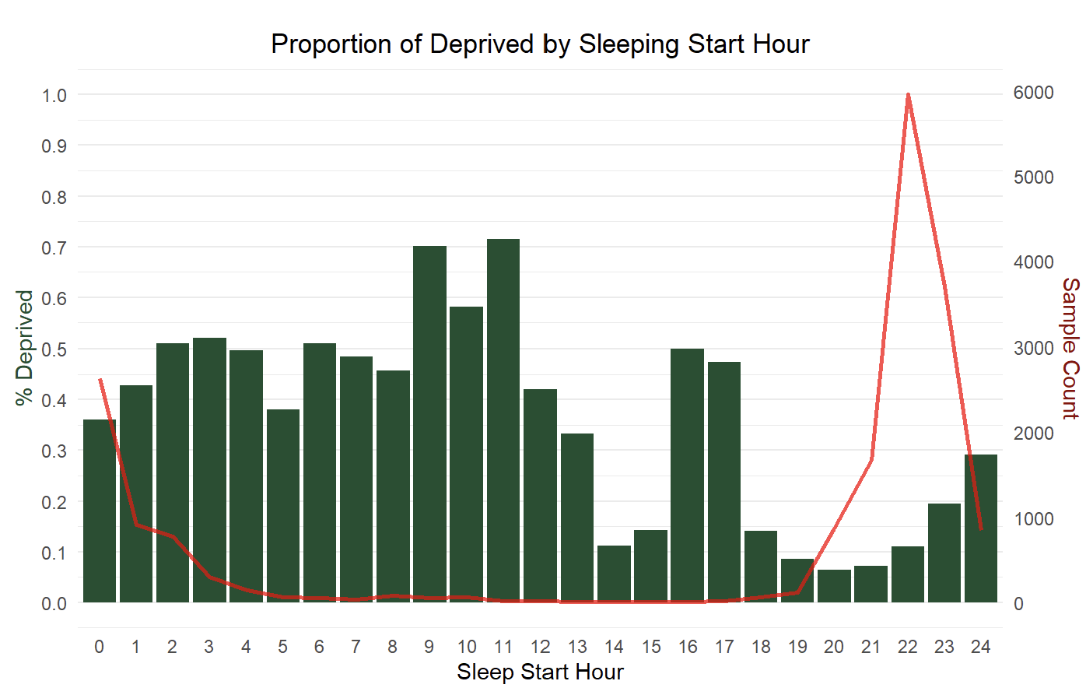
EDA on Selected Features
Key Feature: Bedtime
Notes:
We found bedtime is the most important feature for sleep deprivation. This plot shows the proportion of sleep-deprived people by sleep start time, from 0 to 24 hours.
// You might wonder if bedtime could leak information since our target, sleep deprivation, is based on sleep hours. But bedtime is only the start time of sleep, not the duration. Sleep deprivation depends on total sleep hours, which needs both start time and wake time. Bedtime alone doesn’t reveal the target, so there’s no leakage.
// We also split bedtime into 24-hour bins, the same for train and test data. This keeps bins consistent and prevents any leakage.
—--------------------
Question: Any possible leakage? Did you split it based on full data or train data only?
Answer: There should be no leakage since we split it to 24 hours bin, because technically no different binning decision between train only and full data. 24 hours bin is still 24 hours with exactly same granularity and position.

Slide 10
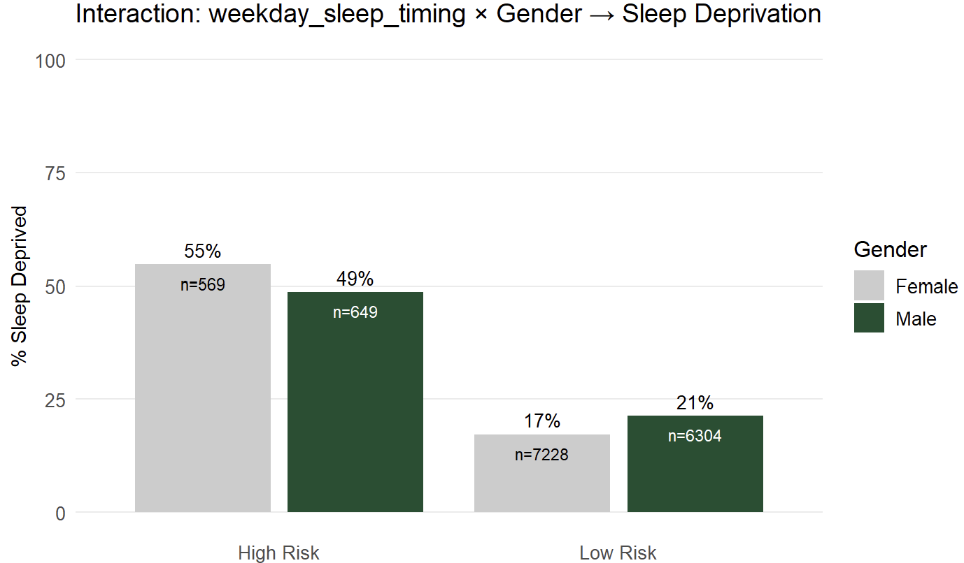
EDA on Selected Features
Key Feature: Bedtime
Notes:
Females have higher sleep deprivation rates than males in the High Risk category (55% vs 49%)
// However, males have higher sleep deprivation rates than females in the Low Risk category (21% vs 17%)
// This visualization is particularly useful because it clearly shows how the effect of gender on sleep deprivation is not constant but varies depending on the sleep timing category.
// The crossing pattern (females higher in one category, males higher in the other) suggests an interaction between these variables.

Slide 11
Feature Engineering
Additional Features
Global features:
waist_to_height_ratio
Features specific to boost the GLM prediction:
binary: weekday_sleep_timing
interaction: weekday_sleep_timing x race
interaction: weekday_sleep_timing x gender
interaction: weekday_sleep_timing x education
Notes:
We added new features to improve our models. First, we created a global feature: [waist-to-height ratio] that helps all models.
// For our GLM, we added specific features to boost performance. Unlike tree-based models or neural networks, GLMs need feature engineering to handle non-linear patterns.
// So, we first created a binary feature named [weekday_sleep_timing]. It splits sleep start times into, for example, low-risk, from 6 PM to 11 PM, and high-risk, from midnight to 5 PM.
// We also added interaction features, such as [weekday_sleep_timing] with race, gender, and education.
// And these variables also helped our GLM models.
Note: There is two sleep timing variable. The first one is 24-hour binning, the second one is binary variable specifically to capture interaction.
—--------------------
for the presenter, you can also mention a bit that unlike modern ML methods like trees or neural nets, GLM needs some feature engineering to break the non-linearity and boost the performance.
cheatsheet: weekday_sleep_timing (binary: low_risk vs high_risk, 18:00-23:00 vs 24:00-17:00)

Slide 12
Modeling: Baseline (Rule-based)
Naive Model (Rule-based)
Conditions
Bedtime between 12:00am and 8:00am
Age between 30 and 60
Current smoker
Very high sedentary level
Prediction
If 2 or more conditions = True → 1
If else → 0
5-fold cross-validated (CV)
AUC | Recall | F1
0.65 | 0.44 | 0.41
Notes:
Then, we started with our rule-based baseline model.
// We first built a simple naive model using rules from our EDA. The conditions include: 1) bedtime between midnight and 8 AM, 2) age between 30 and 60, 3) current smoker, and 4) very high sedentary level.
// For prediction, if two or more conditions are true, we assign Class 1 (sleep deprived), as this threshold balances sensitivity and specificity based on EDA insights. Otherwise, we predict Class 0.
// Then, we evaluated this model with 5-fold cross-validation. The results are like this with AUC of 0.65.

Slide 13
Modeling: Ensemble (Boosting)
Ensemble (Boosting)
Boosting Model: XGBoost Classifier
Handled class imbalance
Set weight for minority class to balance classes (class 0 / class 1)
→ Increased weight for minority class
Hyperparameter tuning
Manual grid search with 5-fold CV
Parameters:
max_depth
learning_rate
n_estimators
class weights
Best parameters based on F1-score (class 1)
5-fold CV with the best model
AUC | Recall | F1
0.77 | 0.69 | 0.52
Notes:
Next, we used XGBoost classifier.
// XGBoost is a powerful boosting algorithm, and we thought is perfect for handling our imbalanced data. Since Class 1 is only about 22%, we increased the weight for the minority class, balancing it with Class 0.
// Then, we tuned hyperparameters using a grid search with 5-fold cross-validation. We tested max depth, learning rate, number of estimators, and class weights, selecting the best, based on F1-score for Class 1.
// With the best model, 5-fold cross-validation gave us an AUC of 0.77, recall of 0.69, and F1-score of 0.52. And especially seeing the recall, we’re catching most sleep-deprived cases, which is critical for health applications.
// And also, compared to our baseline, XGBoost significantly improved performance.

Slide 14
Modeling: Neural Network
Neural Network (MLP)
XGBoost and RF are optimized for overall correctness, but neural net can capture subtle, and higher-order feature interaction.
Model Architecture & Hyperparameters:
Single hidden layer (hidden_layer_sizes ∈ {50, 100, (100, 50)}
L2 weight decay (alpha) ∈ {.00001, .0001, .001} with activations ∈ {ReLU, tnah}
RandomOverSampler to address class imbalance, and optimize with 5-fold CV and GridSearchCV
AUC | Recall | F1
0.69 | 0.63 | 0.47
Notes:
We also tried a neural network model, specifically MLP.
// While XGBoost and Random Forest are great for getting high accuracy, MLPs are really good at picking up subtle, complex patterns in data. Since sleep deprivation is influenced by so many different factors—like bedtime, lifestyle, and more—we thought an MLP could help us capture those tricky relationships.
// For our model, we kept it simple with a single hidden layer and tested different setups, like 50, 100 units structure. We also played around with tuning parameters like L2 weight and testing various activations. To deal with class imbalance, we used random oversampling, and then optimized using 5-fold cross-validation and Grid Search to find the best combination.
// In the end, the results were pretty solid. Compared to our baseline, the MLP did a better job at catching those complex patterns.

Slide 15
Modeling: Ensemble (Stacking)
Ensemble (Stacking)
Base Models: Random Forest + LightGBM + SVM
Meta-data Generation: 5-fold K-Fold stacking
Generate out-of-fold (OOF) predicted probabilities for class 1 from each base model
Combine OOF predictions with top 10 original features
Meta-data scaling for meta-model stability
Meta Model: Logistic Regression
AUC | Recall | F1
0.77 | 0.70 | 0.51
Base Models (Level-1)
Meta-data
Meta Model (Level-2)
Random Forest (RF)
+
Gradient Boosting (LightGBM)
+
Support Vector Machine (SVM)
→ K-fold stacking prediction
OOF probabilities of base models
+
Top 10 original features
→ Input data for meta model
Logistic Regression
→ Final training & prediction
Notes:
Next, in our stacking ensemble model,
// 1) We used three base models: 1) Random Forest, 2) LightGBM, and 3) SVM. And the three models work together to make strong predictions for target.
// 2) For meta-data, we used 5-fold stacking. Each base model generated out-of-fold probabilities for Class 1. We combined these probabilities with the top 10 original features that were selected, like bedtime and age. Then, we scaled the meta-data to ensure stability for the next step.
// 3) Lastly, we used Logistic Regression as our meta-model. It takes the meta-data from the second step and makes the final training and predictions.
// This stacking approach, leveraging diverse models, boosted performance and was effective for our imbalanced data.
—--------------------
Random Forest: Chosen for its robustness and ability to handle noisy data. It combines many decision trees to reduce overfitting and works well with mixed feature types (numerical and categorical).
LightGBM: Selected for its speed and high accuracy in imbalanced datasets. It uses gradient boosting to focus on hard-to-predict cases, like our minority Class 1 (sleep deprivation).
SVM (Support Vector Machine): Picked for its strength in finding complex patterns in high-dimensional data. It excels at separating classes with clear boundaries, even with imbalanced data.

Slide 16
Modeling: GLM – Model Selection
Model | # Variables | # Features | Test AUC | Test Sens | Test F1 | Train F1
Untuned GLM | 28 | 54 | 0.73 | 0.63 | 0.47 | 0.48
AIC Forward | 22 | 67 | 0.77 | 0.71 | 0.51 | 0.51
AIC Backward | 22 | 68 | 0.77 | 0.71 | 0.51 | 0.51
AIC Both | 19 | 64 | 0.76 | 0.71 | 0.51 | 0.51
BIC Forward | 12 | 51 | 0.76 | 0.70 | 0.51 | 0.51
BIC Backward | 14 | 54 | 0.76 | 0.70 | 0.51 | 0.51
BIC Both | 12 | 51 | 0.76 | 0.70 | 0.51 | 0.51
LASSO *) | NA | 59 | 0.76 | 0.71 | 0.52 | 0.51
Ridge *) | NA | 77 | 0.76 | 0.71 | 0.51 | 0.51
Elastic Net *) | NA | 59 | 0.76 | 0.71 | 0.52 | 0.51
*) Regularization introduces shrinkage bias in the estimates, violates the MLE property where direct interpretation becomes impossible
Notes:
BIC is generally more conservative than AIC. So it has tendency to produce in less complex model.
Backward selection tend to produce in more complex model, since it gives chance for every variable to perform. However, this is not a guarantee. Sometimes backward can produce in more simpler model.
Regularization penalize the coefficient which means it introduce a shrinkage bias. This violates the maximum likelihood estimation on GLM, which means the coefficient cannot be used for direct interpretation like GLM. If the intention for regularization is as feature selection, what you can do is select the feature based on regularization, but revert back the coefficient so it allows for direct coefficient interpretation.
For GLM, we select the BIC Forward since it is the least complex model with comparable performance metrics.
Also, if we look at the Untuned GLM, it is nice to see how a feature engineering can boost GLM’s performance.
cheatsheet: weekday_sleep_timing (binary: low_risk vs high_risk, 18:00-23:00 vs 24:00-17:00)
Features specific to boost the GLM prediction:
binarization to breakdown the non-linearity: weekday_sleep_timing_cat
binary: for interaction simplification purpose only
interaction: weekday_sleep_timing x race
unlike modern ML methods like trees or neural nets, GLM needs some feature engineering to break the non-linearity and boost the performance.

Slide 17
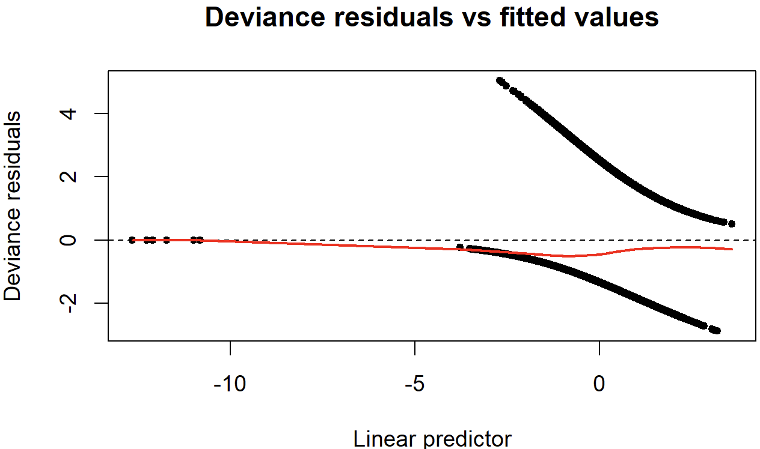
Modeling: GLM – Model Validation
Notes:
The deviance residual for GLM model shows pattern that is:
The average trends of deviance residual against fitted values (red line) is close to zero
Symmetrical spread residual above and below zero
No-obvious non-linear pattern in the residuals
Which indicates that the GLM model is homoscedastic and the current distribution assumption and link function are adequate. There is no need to change to different distribution family nor non-canonical link.
Also, this is actually a very good graphs to show the purpose of logistic link. We can see that the linear predictor is unbounded, logistic link helps to ensure our prediction is within valid probability interval (0,1).
Note that in the left side, it is a perfect prediction where the model perfectly predicts the outcome (either 0 or 1).
FYI:
alternative link -> probit, complementary log-log
alternative distribution -> beta-binomial

Slide 18
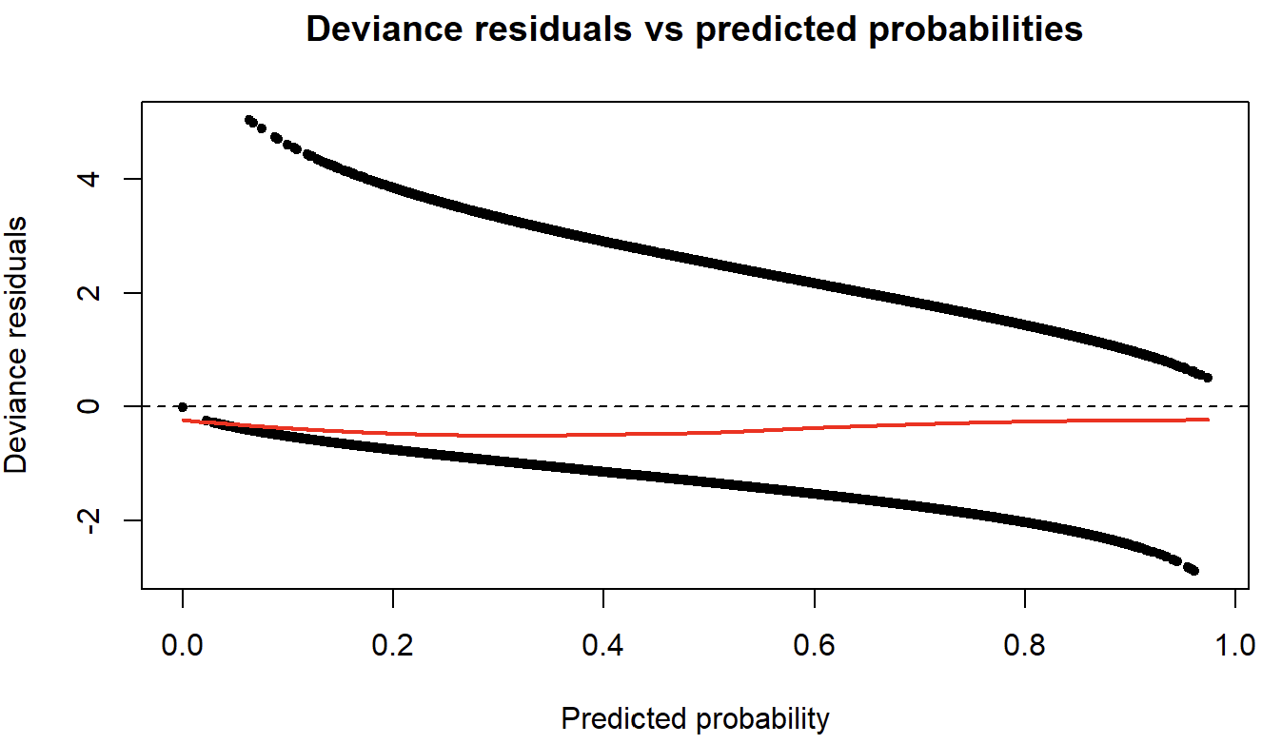
Modeling: GLM – Model Validation
Notes:
Transformed linear predictor. FYI.

Slide 19
Model Evaluation
Performance
Model | Test AUC | Test Sensitivity | Test F1
Naive Model (Baseline) | 0.65 | 0.44 | 0.41
GLM (Untuned) | 0.72 | 0.63 | 0.47
GLM (BIC Forward) | 0.76 | 0.70 | 0.51
Boosting Ensemble (XGBoost) | 0.77 | 0.69 | 0.52
Stacking Ensemble (RF+LightGBM+SVM) | 0.77 | 0.70 | 0.51
Neural Net (MLP) | 0.69 | 0.63 | 0.47
Notes:
In here, we can see, the modern ML methods, they don’t require significant feature engineering to perform well. However, a finely-tuned GLM can also perform as well as more modern ML technique.
We select GLM with BIC Forward as our final model. There is no material differences between a finely-tuned GLM and more advanced ML models. In here, choosing GLM will give us easier interpretation and GLM itself is one of the model with the least complexity.
In short, when the interpretation is less matter, you can just use RF or Boosted Trees for easier implementation. But, when interpretation is crucial, whenever possible, try to fit GLM.

Slide 20
Model Evaluation
K-Fold Cross Validation
Fold | Sensitivity | F1 | AUC
1 | 0.70 | 0.52 | 0.76
2 | 0.67 | 0.48 | 0.77
3 | 0.66 | 0.50 | 0.76
4 | 0.71 | 0.52 | 0.77
5 | 0.70 | 0.51 | 0.77
Average ± SD | 0.69 ± 0.02 | 0.51 ± 0.01 | 0.77 ± 0.01
Train Data | 0.69 | 0.51 | 0.77
Test Data | 0.70 | 0.51 | 0.76
Notes:
This is the cross-validation results and the training-test results for our selected GLM model.
The reason we showed you this is we want to ensure, you are confident that our model have stable performance and not overfitting.

Slide 21
Model Evaluation
Threshold Adjustment
Threshold | Precision | Sensitivity | F1
0.20 | 0.25 | 0.98 | 0.40
0.25 | 0.27 | 0.94 | 0.42
0.30 | 0.29 | 0.89 | 0.44
0.35 | 0.31 | 0.84 | 0.46
0.40 | 0.35 | 0.80 | 0.48
0.45 | 0.38 | 0.76 | 0.50
0.50 | 0.40 | 0.70 | 0.51
0.55 | 0.42 | 0.63 | 0.51
0.60 | 0.44 | 0.55 | 0.49
Notes:
Threshold can be adjusted according to problem definition. For example, if the target objective is a health screening tool, then we might want to raise sensitivity at the cost of misclassifying as false positive. This can be done by reducing your threshold. Similarly, if you need to maximize the specificity, then you raise the threshold.

Slide 22
Model Evaluation
Model Evaluation
Below is some tools that useful to help interpretation for black-box ML model (Ensemble Trees, Neural Nets, etc.):
Variable importance plots
Partial dependence plots
Individual conditional expectation plots
Shapley values
Lift and gain charts
Notes:
This is some tools that is useful for interpretation purpose. This is not adding significant values if GLM is chosen. The most crucial one is shapley values and partial dependence plot.
cheatsheet:
Shapley: quantitative importance of features
PDP: how those features influence predictions across their range of values

Slide 23
Conclusion
Insights
Sleeping Start Hours
Bedtime between 18:00-23:00 shows strong negative coefficients (-1.886), suggesting sleeping early significantly reduce sleep deprivation risk. The strongest protective effects appears between 19:00-21:00 (-2.272) with peak at 20:00 (-2.396).
Health Factors
Tobacco use (+0.217) increases the risk, while stable or moderate weight change (-0.245) has reduced sleep deprivation risk.
Demographics
Males have lower risk than females (-0.337) and college graduates (-0.342) tend to significantly lower risk compared to other education group. Black racial group show observable higher sleep deprivation risk (+0.406) compared to the rest of racial group (-0.125).
Interaction Effect (sleep start hours x gender)
Sleep timing patterns impact males (+0.562) differently than females.
Notes:
This is our high-level conclusion. Sleeping start hours have the most impactful effect on sleep deprivation odds.
Our conclusion in here is not very technical, because it is intended to support the decision maker with clear information. In our case, we can clearly say how each variable affecting sleep deprivation odds. For example, based on the result, the CEO can encourage HR department to focus on promoting sleep health, with more targeted approach and clear quantifiable performance metric.
We also found that Black individuals had higher odds of sleep deprivation risk compared to other groups. This suggests there might be factors that may affect the sleep health, like access to healthcare, work schedules, genetics, we don’t know.. And this is worth to investigate for future research.
Is it ethical to use race as predictor? It is more unethical to exclude the race, since it’s basically dismissing a potential of underlying issue that might require intervention.

Slide 24
Challenges
Challenges
Measurement Limitations: Sleep timing is self-reported in NHANES, it may introduce recall bias or misreporting.
Causality vs. Association: The results are associational, it might require stronger causal designs to explore causes of sleep deprivation risk (e.g., experimental studies).
Future Directions
Causal Modeling: Apply causal inference methods (PS matching/weighting, structural causal model)
Subgroup Analyses: Explore heterogeneity more deeply by occupation, SES, mental health to better understand risk profiles

Slide 25
Appendix: References
[1] G´eron, A. (2019). Hands-On Machine Learning with Scikit-Learn, Keras, and Tensor-
Flow. O’Reilly Media.
[2] James, G., Witten, D., Hastie, T., & Tibshirani, R. (2013). An Introduction to Statistical
Learning. Springer.

Slide 26
End of Presentation

Slide 27
Templates (To-be deleted)
Model Evaluation
XGBoost Classifier

Slide 28
Introduction
Problem
Sleep deprivation is a widespread but underdiagnosed health issue.
Symptoms like fatigue often mimic other conditions (e.g., depression, hypertension), making detection difficult.
While traditional identification relies on self-reported sleep questionnaires, incorporating health, demographic, and lifestyle factors can more robustly flag sleep deprivation risk.
Project Goal
Develop a predictive model to flag individuals at risk of sleep deprivation using existing clinical and survey data
Identify key determinants of sleep deprivation, focusing on demographic factors, health behaviors, and biological markers.
Support healthcare providers with a low-cost, scalable screening tool for routine visits.
Raise public and clinical awareness about sleep health using U.S. population-level data (NHANES).

